Slide 1
Datatypes
Many-sorted term languages

Slide 2
Syntax
TermLanguage ::= “datatype” TypeId “=” ConstructorList
TypeId ::= id
ConstructorList ::= ConstructorDef “|” ConstructorList
| ConstructorDef
ConstructorDef ::= nullaryId
| constructorId “of” TypeExpr
nullaryId ::= id
constructorId ::= id
* TypeId is a new (user-defined) type.

Slide 3
TypeExpr ::= TypeTerm “->” TypeExpr
| TypeTerm
TypeTerm ::= TypeFactor “*” TypeTerm
| TypeFactor
TypeFactor ::= TypeFactor “list”
| TypeBase
TypeBase ::= PrimitiveType | “(” TypeExpr “)”
PrimitiveType ::= int | bool | string | …
* Type expressions in SML are more complex that what is shown here.
** The tuple operator is associative (not left associative or right associative).

Slide 4
Nullary Functions (AKA Constants, AKA enumerated types)
datatype days = Monday
| Tuesday
| Wednesday
| Thursday
| Friday
| Saturday
| Sunday;

Slide 5
datatype days = Monday
| Tuesday
| Wednesday
| Thursday
| Friday
| Saturday
| Sunday;
fun toNumber Monday = 1
| toNumber Tuesday = 2
| toNumber Wednesday = 3
| toNumber Thursday = 4
| toNumber Friday = 5
| toNumber Saturday = 6
| toNumber Sunday = 7;
toNumber Wednesday;
toNumber (Sunday);

Slide 6
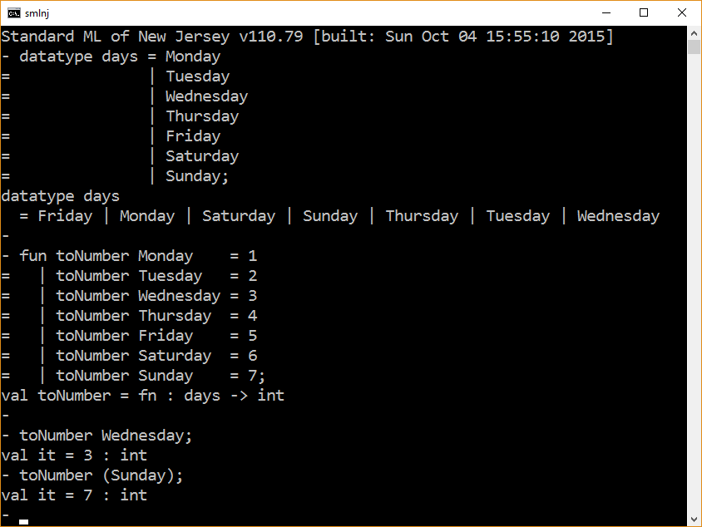

Slide 7
datatype days = Monday
| Tuesday
| Wednesday
| Thursday
| Friday
| Saturday
| Sunday;
fun toWeekday 1 = Monday
| toWeekday 2 = Tuesday
| toWeekday 3 = Wednesday
| toWeekday 4 = Thursday
| toWeekday 5 = Friday
| toWeekday 6 = Saturday
| toWeekday 7 = Sunday
(* assumes year day numbering starts with 1 *)
fun yearDayNumberToWeekday n = toWeekday( (n-1) mod 7 + 1 );
yearDayNumberToWeekday 8;
yearDayNumberToWeekday 14;

Slide 8
Modeling Denotable Values
datatype denotable_value = Boolean of bool
| Integer of int;
val store = [ (0,Boolean true), (1, Integer 5) ];

Slide 9
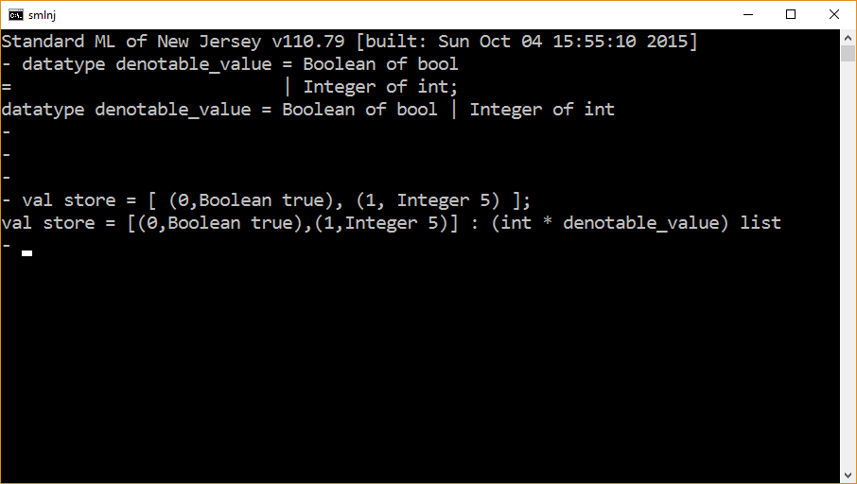

Slide 10
Arithmetic Expressions
datatype math = plus of math * math
| mult of math * math
| num of int;
plus( num 5, num 6 );
mult( num 5, plus( num 6, num 7 ) );

Slide 11
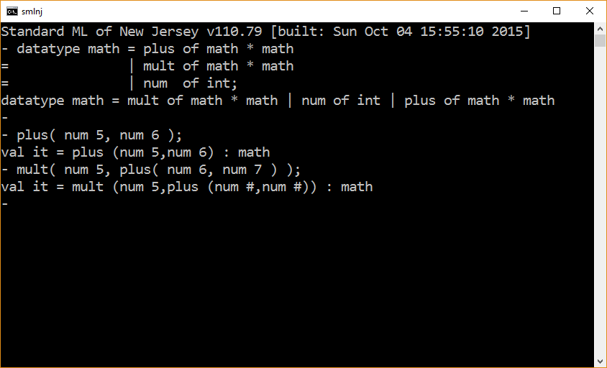

Slide 12
datatype math = plus of math * math
| mult of math * math
| num of int;
fun dist( mult(x, plus(y,z)) ) = plus(mult(x,y), mult(x,z))
| dist term = term;
dist( mult(num 5, plus(num 6, num 7)) );
* the implementation of the function dist is not complete.

Slide 13
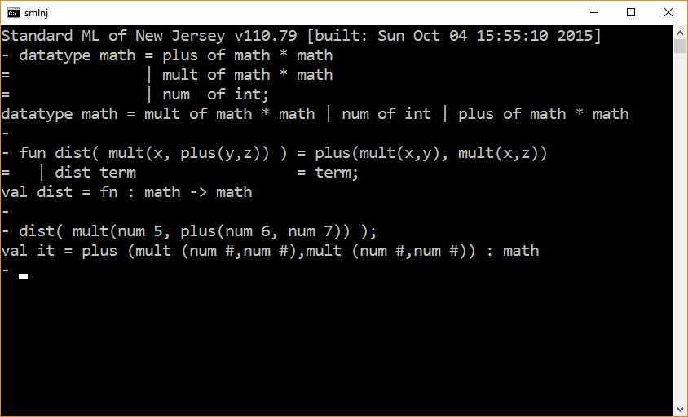

Slide 14
datatype math = plus of math * math
| mult of math * math
| num of int;
fun printMathInPNF( plus( x,y ) ) = (
print “(”;
printMathInPNF x;
print “ + ”;
printMathInPNF y;
print “)”
)
| printMathInPNF( mult( x,y ) ) = (
print “(”;
printMathInPNF x;
print “ * ”;
printMathInPNF y;
print “)”
)
| printMathInPNF( num x ) = print( Int.toString x );
printMathInPNF( mult(num 5, plus(num 6, num 7)) );

Slide 15
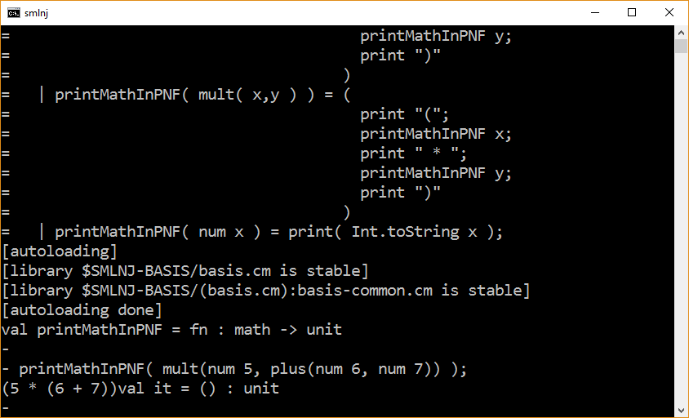

Slide 16
datatype math = plus of math * math
| mult of math * math
| num of int;
fun pnf( operator, term1, term2 ) = (
print “(”;
printMathInPNF term1;
print operator;
printMathInPNF term2;
print “)”
)
and printMathInPNF( plus( x,y ) ) = pnf( “ + ”, x, y )
| printMathInPNF( mult( x,y ) ) = pnf( “ * ”, x, y )
| printMathInPNF( num x ) = print( Int.toString x );
(
print “\n\n”;
printMathInPNF( mult(num 5, plus(num 6, num 7)) );
print “\n\n”
);

Slide 17
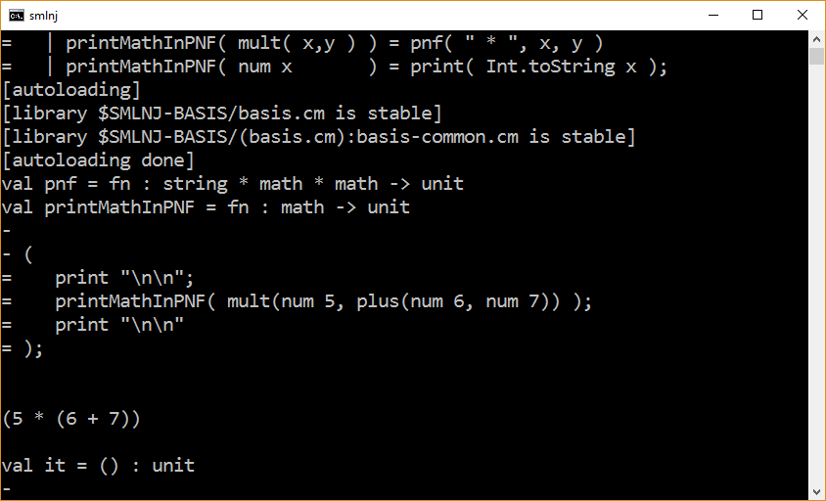

Slide 18
An interesting improvement
Write a function that takes as input an expression of type math and outputs a corresponding infix expression (i.e., an arithmetic expression using traditional infix syntax) having the minimum number of parenthesis.

Slide 19

Modeling trees
Trees in general and parse trees in particular.

Slide 20
Binary Trees
datatype btree = tree of string * btree * btree
| NIL;
val t0 = NIL;
val t1 = tree(“1”,t0, t0);
val t2 = tree(“2”,t1 ,t1);
val t3 = tree(“3”,t2, t2);

Slide 21
datatype btree = tree of string * btree * btree
| NIL;
fun printTree NIL = ()
| printTree (tree(node,left,right)) = (
print(“\n” ^ node);
printTree left;
printTree right
);
val t0 = NIL;
val t1 = tree(“1”,t0, t0);
val t2 = tree(“2”,t1 ,t1);
val t3 = tree(“3”,t2, t2);
printTree t3;

Slide 22
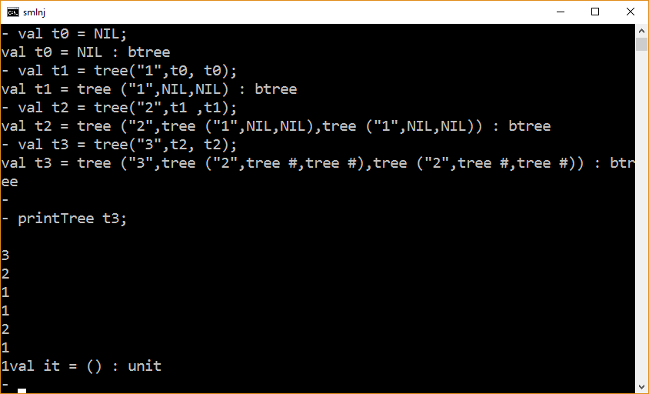

Slide 23
datatype btree = tree of string * btree * btree
| NIL;
val LM = “\n”;
val tab = “ ”;
fun printTree (_, NIL) = ()
| printTree (LM, tree(node,left,right)) =
(
print(LM ^ node);
printTree (LM ^ tab, left );
printTree (LM ^ tab, right)
);
val t0 = NIL;
val t1 = tree(“1”,t0, t0);
val t2 = tree(“2”,t1 ,t1);
val t3 = tree(“3”,t2, t2);
printTree (LM,t3);

Slide 24
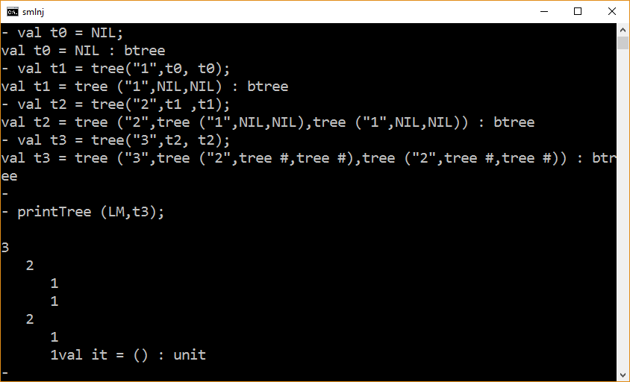

Slide 25
datatype btree = tree of string * btree * btree
| NIL;
val LM = “\n”;
val tab = “|---”;
fun printTree (_, NIL) = ()
| printTree (LM, tree(node,left,right)) =
(
print(LM ^ node);
printTree (LM ^ tab, left );
printTree (LM ^ tab, right)
);
val t0 = NIL;
val t1 = tree(“1”,t0, t0);
val t2 = tree(“2”,t1 ,t1);
val t3 = tree(“3”,t2, t2);
( printTree (LM,t3); print “\n\n” );

Slide 26
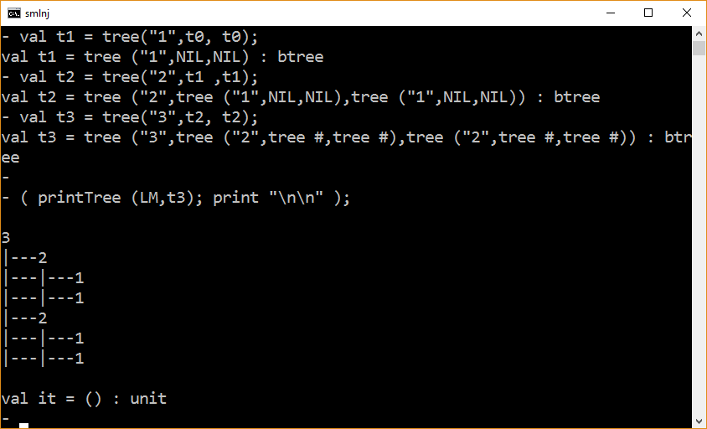

Slide 27
n-ary Trees (for arbitrary N)
datatype nary_tree = tree of string * nary_tree list;
val t0 = tree(“1”,[]);
val t1 = tree(“2”,[t0]);
val t2 = tree(“3”,[t1,t1]);
val t3 = tree(“4”,[t2,t2,t2]);

Slide 28
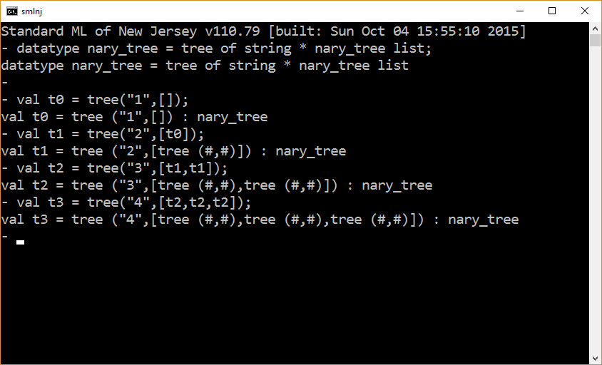

Slide 29
datatype nary_tree = tree of string * nary_tree list;
val t0 = tree(“stmtList”,[]); (* stmtList ::= ε *)
val t1 = tree(“id”,[tree(“x”,[])]);
val t2 = tree(“stmt”,[ t1, (*stmt ::= id ++ *)
tree(“++”,[])
]
);

Slide 30
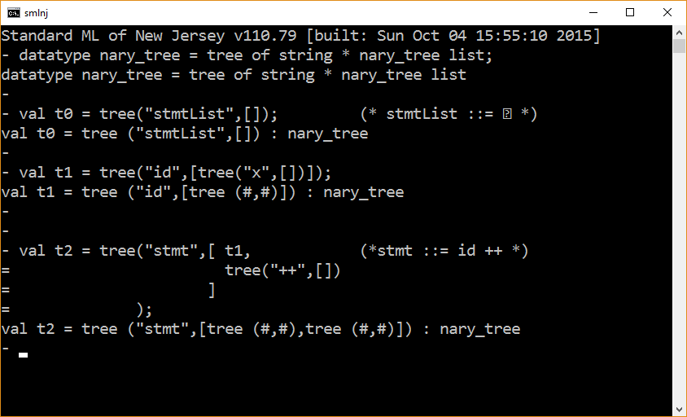

Slide 31
How the TL system models parse treeS
datatype NODE_INFO = …; (* e.g., line, column, file info)
datatype INODE = inode of string * NODE_INFO;
datatype ITREE = itree of INODE * ITREE list;

Slide 32
The End

